Slide 1
2500 Series® HMI Panels

Slide 2
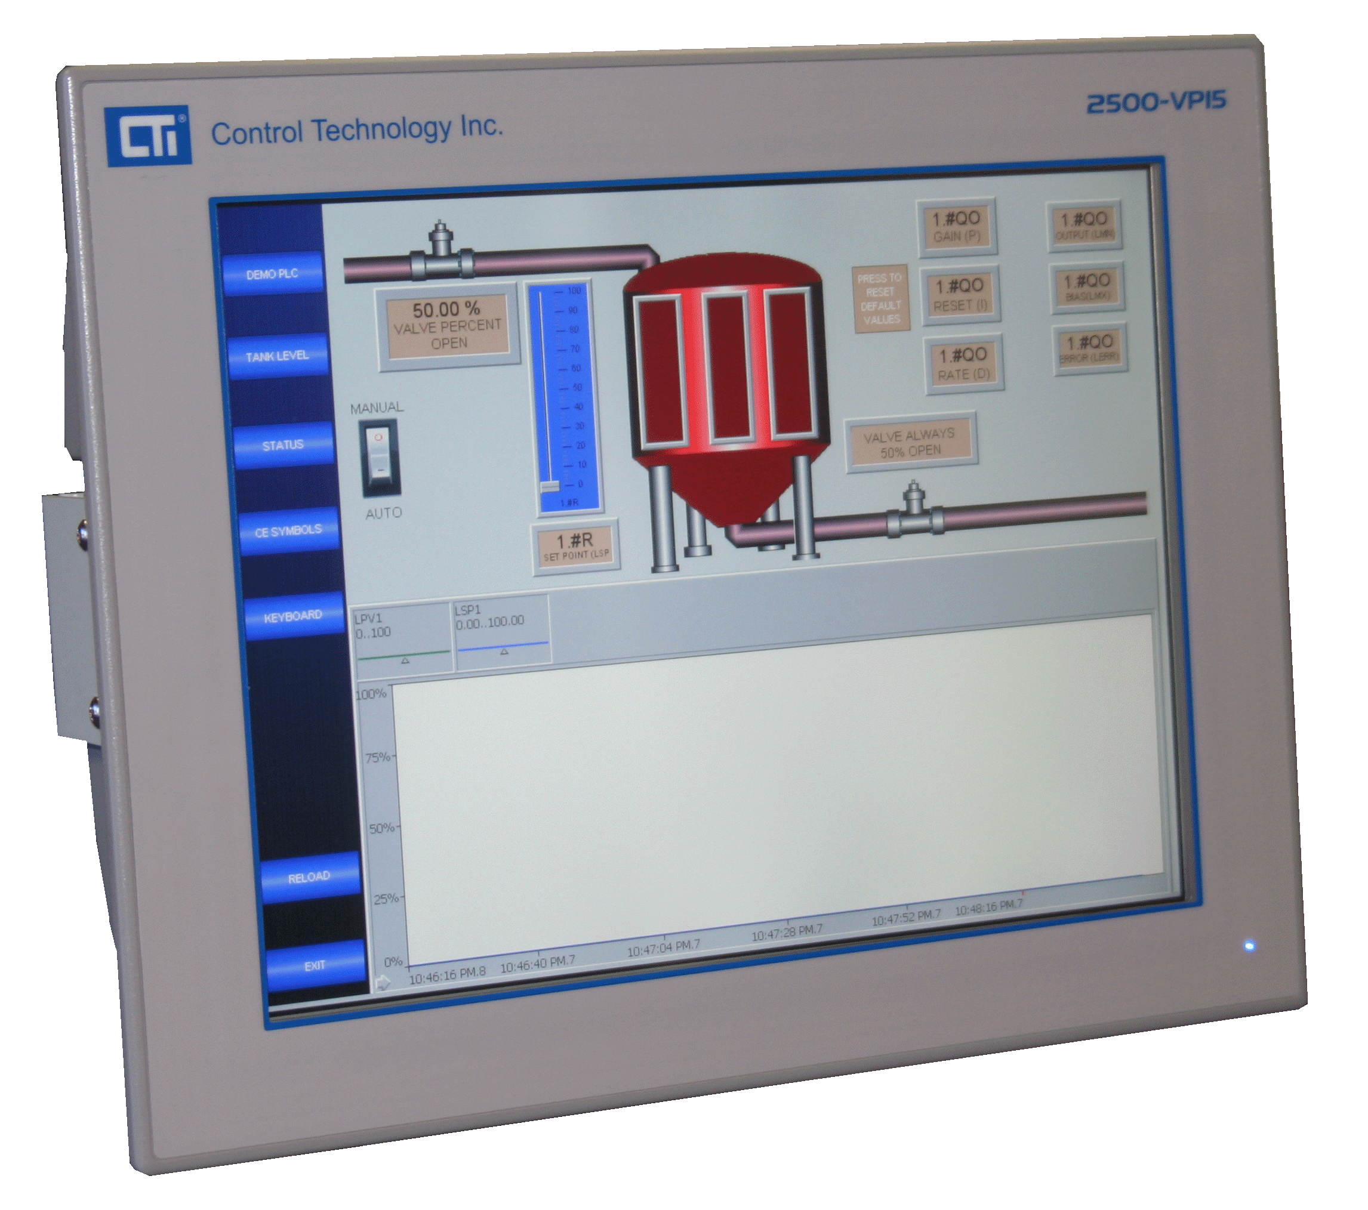
New 2500 Series® HMI Panels Overview
HMI Panel
Why is CTI Offering an HMI solution?
Most existing 2500 Series® installations use some HMI panel or panel-PC
Other companies are dropping their support for Ethernet solutions
This is the first step of a planned fully integrated solution that uses a single tag database and single development tool for control logic and visualization

Slide 3
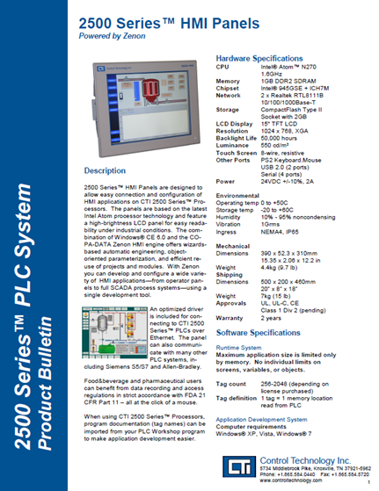
New 2500 Series® HMI Panels Overview
HMI Panel
Launched in 2011
Two Versions
HMI version uses “Zenon” HMI configuration and runtime software
Windows® 7 Embedded “panel PC” version allows you to install your own HMI application
Full HMI version is designed for “plug and play” installation with 2500 Series® Processors
Driver is included for attachment to CTI 2500 Series® and Siemens® 505 processors over Ethernet

Slide 4
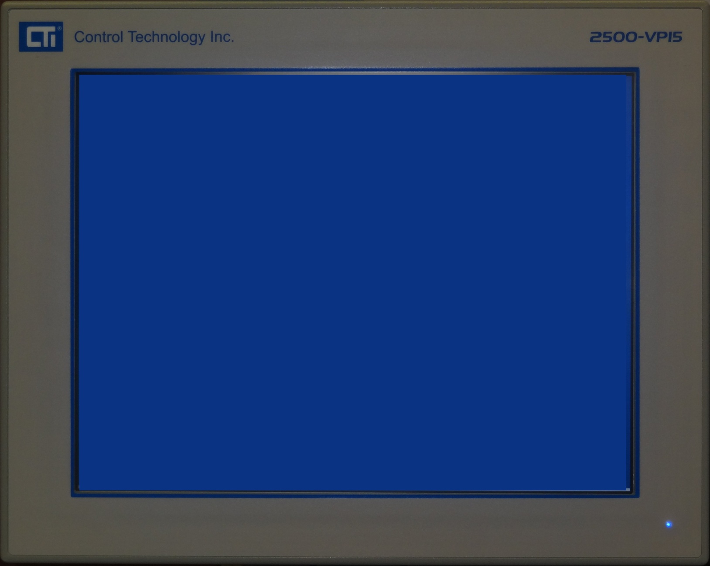
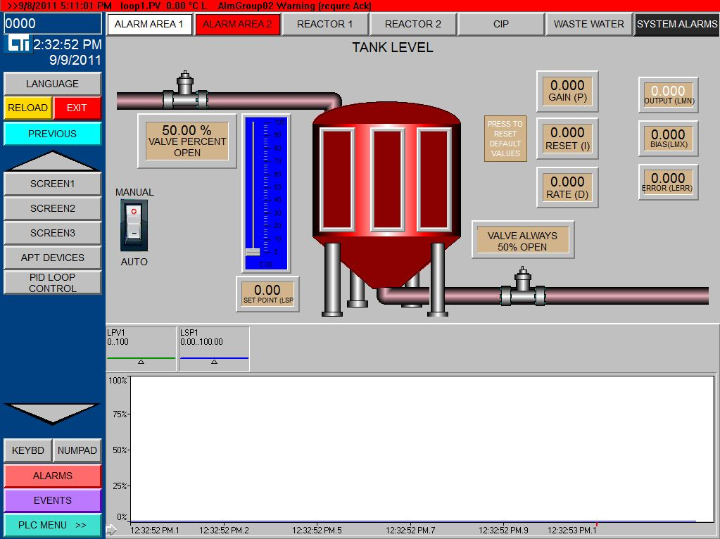
Introducing the New CTI 2500 Series® HMI Panel . . .

Slide 5
New 2500 Series® HMI Panels Introduction
Home
What is so important about the new CTI 2500 Series HMI panel?

Slide 6
New 2500 Series® HMI Panels Introduction
Home
The new CTI HMI panel has CAPABILITY and EFFICIENCY!
Uses a Powerful 1.6Ghz Intel Atom Processor
Modern Hardware Chipset can Handle Demanding Graphics
Low CPU Power Consumption (2.5 Watts)
Low Heat Generation
Requires Only Passive Cooling (No fans)
Atom CPU vs. Penny

Slide 7
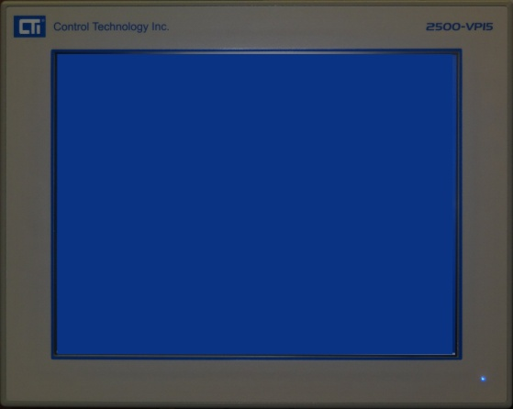
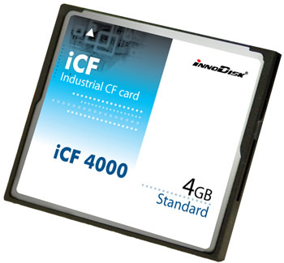
New 2500 Series® HMI Panels Introduction
Home
The new CTI HMI panel has STABILITY and DURABILITY!
Operating System Files and HMI Project Files are stored in Compact Flash memory (2-3 times more Reliable than Hard Disk Drives)
Front Panel is Rated NEMA4 and IP65 for Indoor or Outdoor Installations Requiring Water and Dust Protection.
NEMA 4 / IP65

Slide 8
New 2500 Series® HMI Panels Introduction
Home
The new CTI HMI Panel has VISIBILITY!
550 nit Super Bright Color LCD Display
1024 x 768 (XGA) graphics resolution

Slide 9
New 2500 Series® HMI Panels Introduction
Home
The new CTI HMI Panel has CONNECTIBILITY!
2x Realtek 1-Gigabit Ethernet Controllers
2x fully Isolated RS-232 ports
2x RS-232/422/485 ports
2x USB 2.0 ports (Industrial keyboards, pointing devices, external drives)
CTI driver presently connects using Ethernet

Slide 10
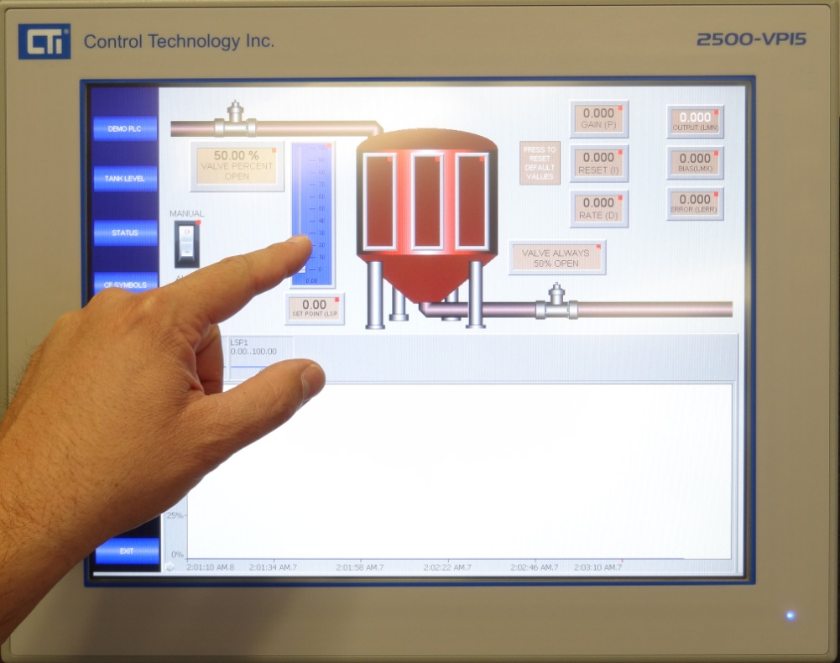
New 2500 Series® HMI Panels Introduction
Home
The CTI Panel has TOUCHIBILITY!
Uses an 8-Wire Resistive Touchscreen for More Accurate Touch Operation
Other Panel Manufacturers use a 5-Wire Touchscreen.

Slide 11
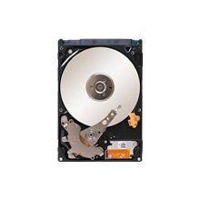
New 2500 Series® HMI Panels Introduction
Home
The CTI Panel has EXPANDABILITY!
Optional Compact Flash Upgrade to 16Gb
Optional Internal SATA Hard Drive for Data Collection
HMI Upgrades

Slide 12
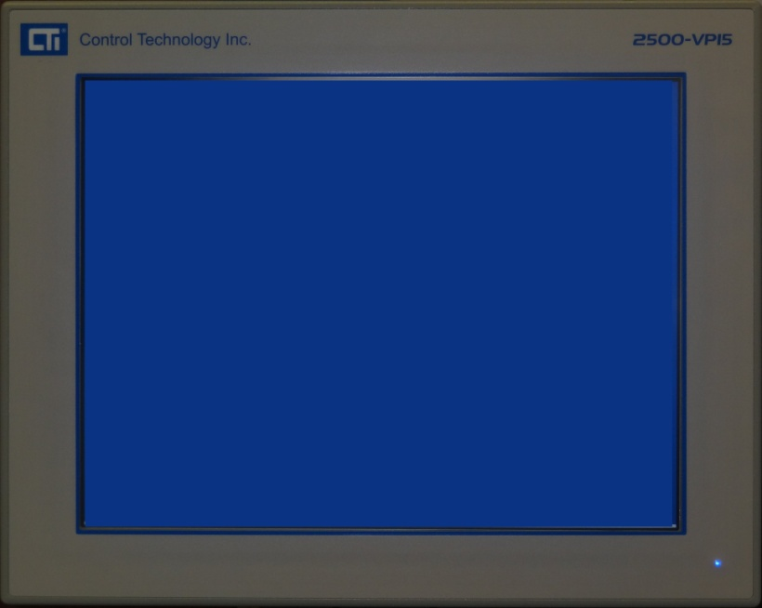
New 2500 Series® HMI Panels Introduction
Home
The Best of both worlds!
2500 Series® HMI Panel Hardware is designed for high performance!
2500 Series® HMI Panel Software is ZENON by Copa-Data, a powerful and versatile HMI/SCADA engine

Slide 13
New 2500 Series® HMI Panels Introduction to Zenon
Home
ZENON is Emerging as a Leading HMI/SCADA Software
Zenon is already used by top companies worldwide to handle some or all of their HMI and SCADA applications.
“After an intensive evaluation of all leading HMI/SCADA systems, the BMW Group decided in favour of world-wide implementation of ZENON®”

Slide 14
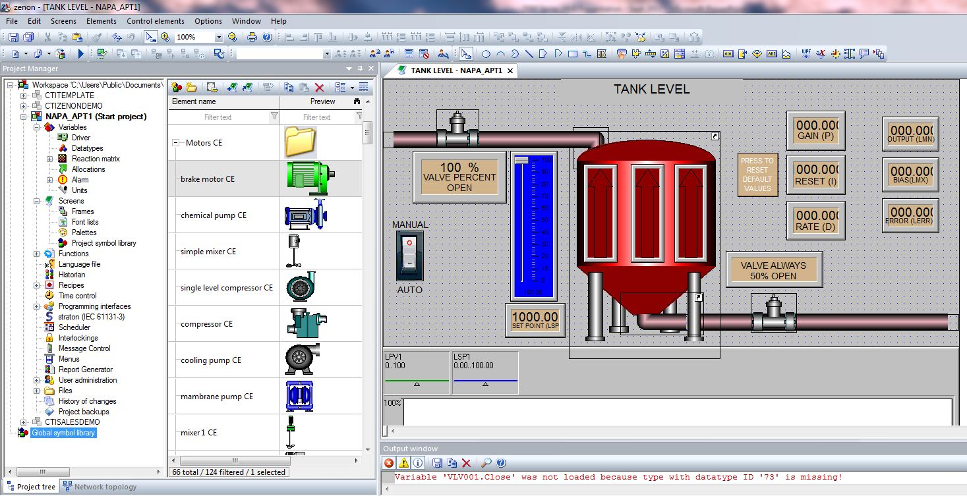
New 2500 Series® HMI Panels Introduction to ZENON
Home
The Zenon HMI Editor Software is a Powerful Tool for Creating HMI projects

Slide 15
New 2500 Series® HMI Panels Introduction to Zenon
Home
The Zenon Editor is Designed to Make Engineering Simple
Large number of PLC drivers available (Allen Bradley, Beckhoff, Koyo, CTI, Siemens, TI, Mitsubishi, Modicon, Omron, Hitachi, & many more).
Stores properties like alarm limits, scaling factors, and status colors in its variables rather than in objects. This object-based approach gives items their properties from the linked variable, and is unique to Zenon.
‘Frames’ which automate the size, location, and color settings of each screen. This object-based approach is unique to Zenon.

Slide 16
New 2500 Series® HMI Panels Introduction to Zenon
Home
The Zenon Editor is Designed to Make Engineering Simple.
A screen in Zenon which displays information from one process area can be toggled to display similar process information from another area without having to design a second screen.
Zenon allows the user to create embedded graphical symbols with linked variables. When making a copy of an embedded symbol, Zenon automatically prompts you to keep or replace the variable links.
Zenon includes a Visual Basic interface allowing the user to create wizards which automate common design tasks like variable creation, variable importing, and language file creation.

Slide 17
New 2500 Series® HMI Panels Introduction to Zenon
Home
The Zenon Editor is Designed to Make Engineering Simple.
To merge multiple projects into one master project, it only takes a few minutes. You need only create the master project and then insert desired existing projects as sub-projects into your master project tree. Now from one location you can monitor and control several process areas.
Zenon is backwards compatible! This means that there is NO need to upgrade an older version Zenon project on a network when a newer Zenon device is added!

Slide 18
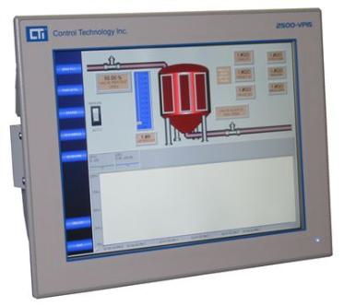
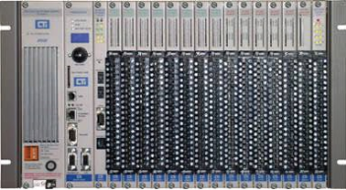
New 2500 Series® HMI Panels Zenon Network Flexibility
Home
The CTI HMI Panel is Optimized to Communicate with one or many CTI 2500 Series® CPUs
2500-VP15-N4-W7R
2500-VP15-N4-W7R
Ethernet
Ethernet

Slide 19
New 2500 Series® HMI Panels Zenon Network Flexibility
Home
Multiple CTI HMI Panels can Share Data and Control with Multiple CTI PLC’s.
2500-VP15-N4-W7R
2500-VP15-N4-W7R
Ethernet

Slide 20
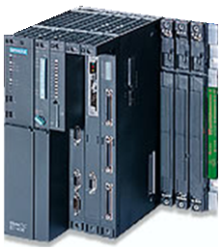
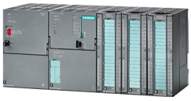
New 2500 Series® HMI Panels Zenon Network Flexibility
Home
Multiple CTI HMI Panels can Share Data and Control with Multiple PLC’s of Different Brands. The CTI Panel can be a gateway between Different Brand PLC’s.
2500-VP15-N4-W7R
2500-VP15-N4-W7R
Ethernet

Slide 21
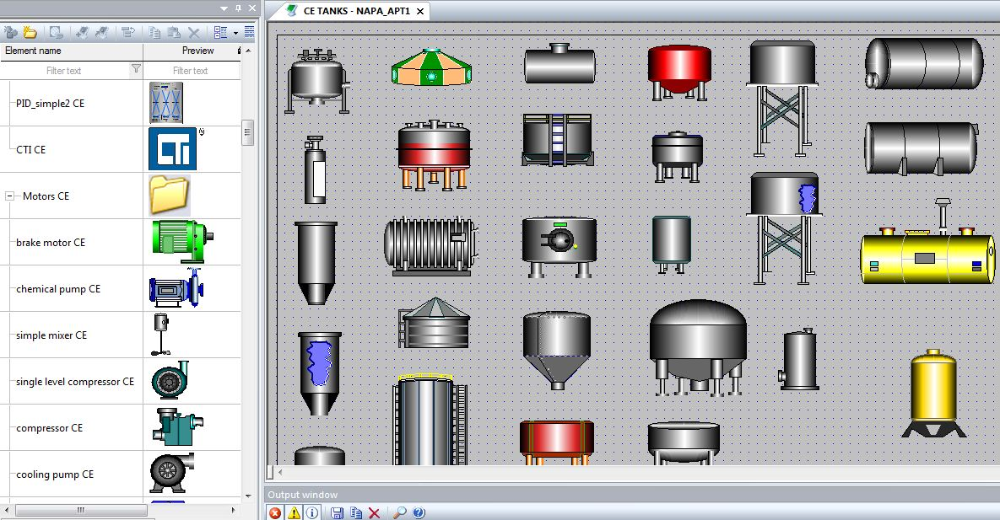
New 2500 Series® HMI Panels Zenon Feature – GRAPHICAL SYMBOLS
Home
A Large Library of Symbols is Available in Zenon. Users can Also Create Symbols of Their Own.

Slide 22
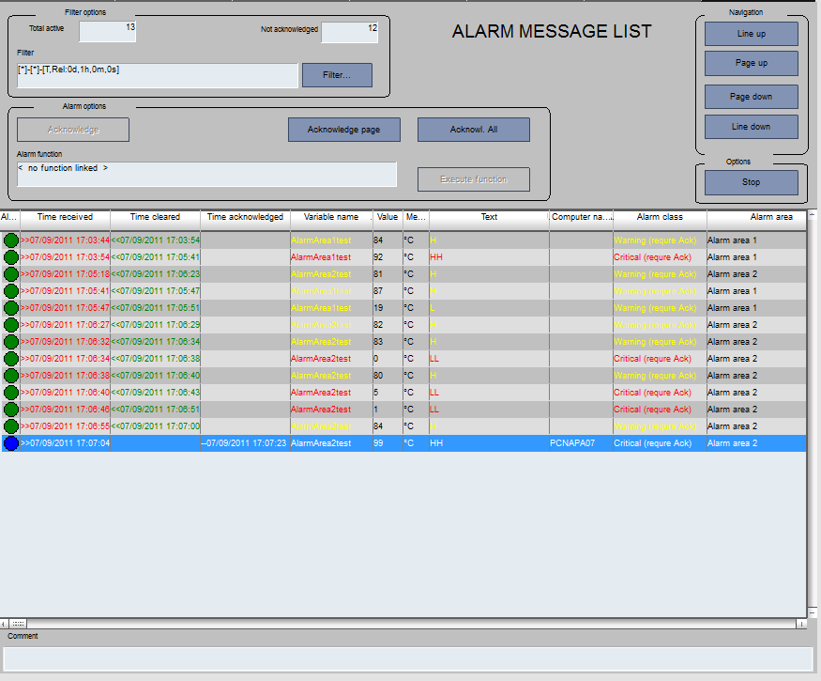
New 2500 Series® HMI Panels Zenon Feature – ALARM SCREENS
Home
Zenon Makes Creating Process Alarm Screens Easy so that You can Monitor, Track, and Respond to Changing Process Conditions .
An Authorized User Can Acknowledge and Enter a Comment for Each Alarm.

Slide 23
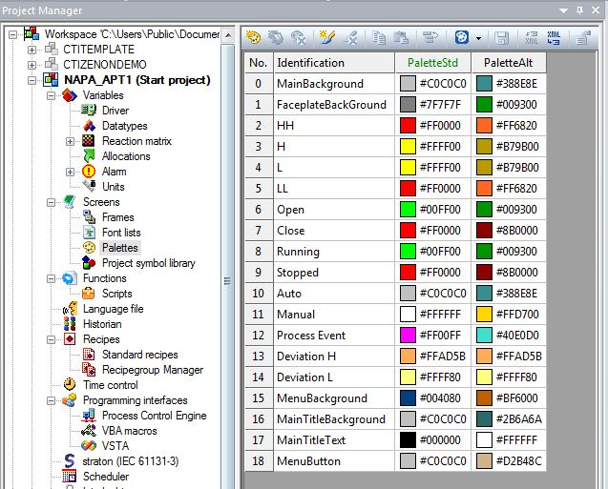
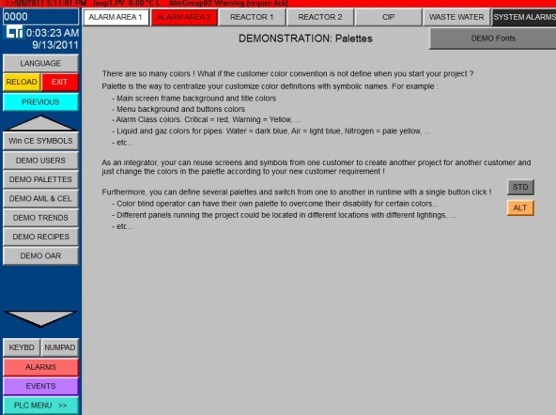
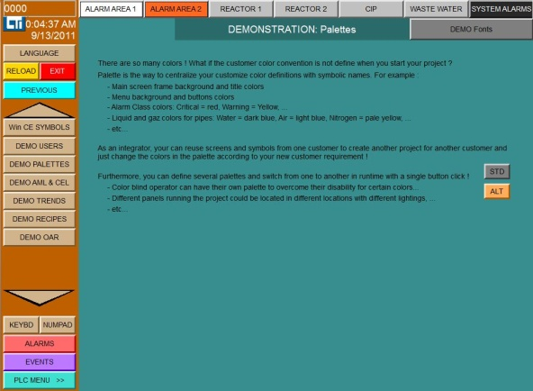
New 2500 Series® HMI Panels Zenon Feature – COLOR PALETTES
Home
Zenon Allows Alternate Color Palettes to be Quickly Activated in Your Project with the Push of a Button.

Slide 24
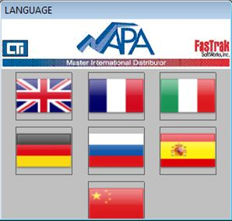
New 2500 Series® HMI Panels Zenon Feature – LANGUAGE FILES
Home
Language Files can be Created in Zenon to Allow Process Screens to Display Alternate Languages.

Slide 25
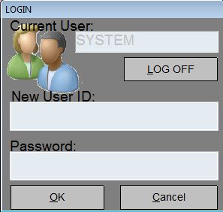
New 2500 Series® HMI Panels Zenon Feature – USER ADMINISTRATION
Home
Zenon Gives You the Ability to Control the Access that Users Have to Information, Settings, and Controls on Your HMI Panel Screens.

Slide 26
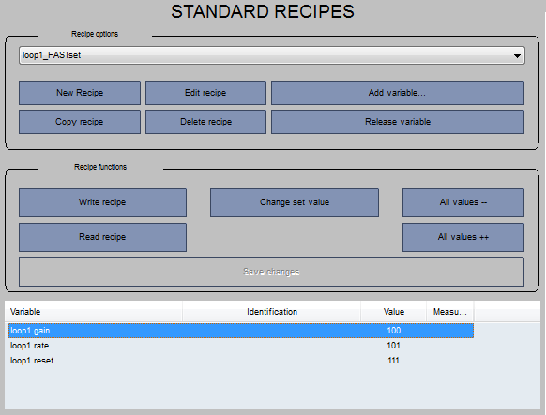
New 2500 Series® HMI Panels Zenon Feature – STANDARD RECIPES
Home
Zenon Gives You the Ability to Make Process Changes via its Standard Recipe Manager. Authorized Users can Add, Change, and Delete Recipes within Your Project.

Slide 27
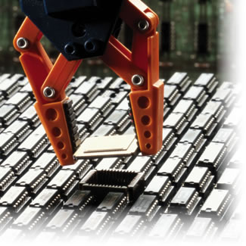
New 2500 Series® HMI Panels Zenon Feature – Video Screens
Home
The CTI HMI Panel with Zenon Can Display High Resolution Video in AVI format.

Slide 28
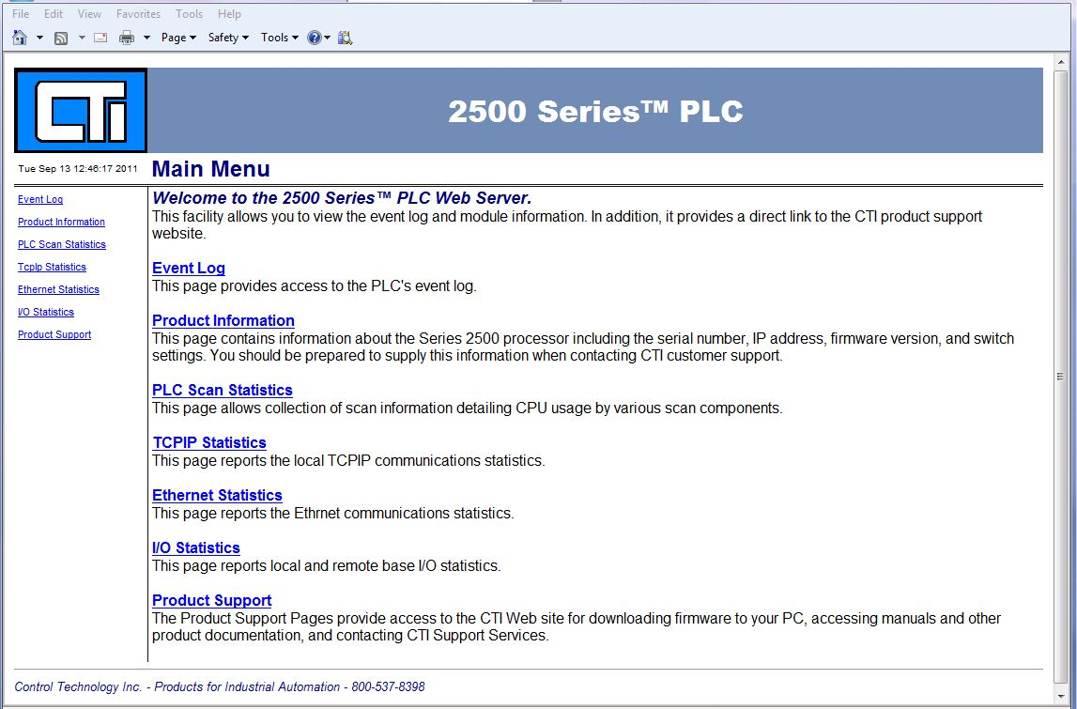
New 2500 Series® HMI Panels Zenon Feature – CTI PLC Webpage
Home
The CTI HMI Panel with Zenon Can Display the Webpage of the CTI 2500 Series PLC Processor. You Can Access the Event Log, Status Information, and PLC Statistics.

Slide 29
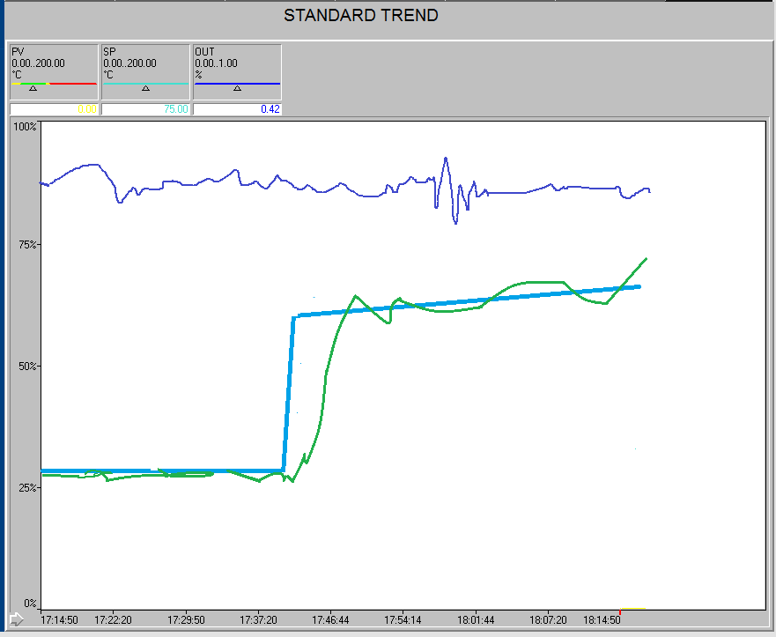
New 2500 Series® HMI Panels Zenon Feature – Standard Trend Charts
Home
Zenon Gives You the Standard Ability to Add Trend Charts to Your Screens to View Realtime Data on the CTI HMI panel.

Slide 30
New 2500 Series® HMI Panels Trending and Archiving
Home
Optional Extended Trend & Historian, Starter Edition
used for the representation of online and historical values (archive values) of process variables and derived process variables in form of curves
It makes it possible to review historic data
Displays up to 8 curves with multiple y-axes and scrolling
CTI recommends the addition of an internal or external hard drive if data logging is required.

Slide 31
New 2500 Series® HMI Panels Zenon Feature – Integrated IEC6-1131 Soft PLC
Home
Zenon Includes a Powerful Integrated Soft PLC that Runs on The CTI HMI Panel.
Additional Logic can be performed in the Soft PLC engine running on the CTI HMI Panel.
The Standard License limits the user to 8 variable tags.
IEC 61131-3 programming interface
Ladder Diagram
Instruction List
Structured Text
Function Block Diagram
Sequential Function Chart

Slide 32
2500-VP15 HMI Panel Maintenance and Support Options
HMI Panel
Standard warranty is 2yr on hardware and 60 days on software. BASIC SUPPORT is included at no additional charge.
Basic Support
Free lifetime support by email is standard on all HMI panels.

Slide 33
2500-VP15 HMI Panel Maintenance and Support Options
HMI Panel
Premium Annual Support
Includes priority access to telephone support
Extended Hardware Warranty
Available in 1yr, 2yr, 3yr terms
Must be purchased within 60 days of the ship date of the HMI panel
Includes advanced replacement for warranty hardware failures (2 business days, ex Works).

Slide 34
2500-VP15 HMI Panel Maintenance and Support Options
HMI Panel
Annual Runtime Software Maintenance
Includes 1-year free upgrades on the Zenon runtime software installed on the HMI panel
Must be purchased within 60 days of the ship date of the HMI panel
Annual Development Software Maintenance
Includes 1-year free upgrades on the Zenon Application Development Software for Windows®
Must be purchased within 60 days of the ship date of the HMI panel

Slide 35
2500-VP15 HMI Panel Ordering Information
HMI Panel
HMI Panel
2500-VP15-N4-W7R 15” HMI Panel, Windows® 7 Embedded, NEMA4,
256 tag
2500-Z256-512 Runtime 256-tag to 512-tag upgrade
2500-Z256-1024 Runtime 256-tag to 1024-tag upgrade
2500-Z256-2048 Runtime 256-tag to 2048-tag upgrade
2500-Z512-1024 Runtime 512-tag to 1024-tag upgrade
2500-Z512-2048 Runtime 512-tag to 2048-tag upgrade
2500-Z1024-2048 Runtime 1024-tag to 2048-tag upgrade
Runtime Software Options
2500-Z-ETAS Extended Trend & Historian, Starter Edition
2500-Z-WSP Web Server Pro (coming late 2012)

Slide 36
2500-VP15 HMI Panel Ordering Information
HMI Panel
Development Software
2500-Z2K-DEV-USB Zenon Application Development Software (Editor), maximum 2048 tags, USB Dongle License Key
Maintenance and Support
2500-VP15-BSC Basic Support (included at no charge)
2500-VP15-ASC Premium Annual Support
2500-VP15-EXW1 Extended Hardware Warranty, 1-year (total warranty 3 years)
2500-VP15-EXW2 Extended Hardware Warranty, 2-years (total warranty 4 years)
2500-VP15-EXW3 Extended Hardware Warranty, 3-years (total warranty 5 years)

Slide 37
2500-VP15 HMI Panel Ordering Information
HMI Panel
Maintenance and Support (continued)
2500-Z256-RT-AMP Annual Runtime Software Maintenance, 256 tag
2500-Z512-RT-AMP Annual Runtime Software Maintenance, 512 tag
2500-Z1K-RT-AMP Annual Runtime Software Maintenance, 1K tag
2500-Z2K-RT-AMP Annual Runtime Software Maintenance, 2K tag
2500-Z2K-DEV-AMP Annual Development Software Maintenance, 2K tag

