Slide 1
Control Technology Incorporated
Process Control System Modernization

Slide 2
Modernization versus Migration Needs Assessment

Slide 3
Aging control systems a concern. Worries include:
  Reliability – component failures, operations risk, unplanned downtime
  Maintenance – cost/availability of spares, availability of engineering know-how, availability of support
  Communications capabilities -- data exchange with HMI/SCADA, communications with old or new machinery
  Operational capabilities – speed, flexibility, ability to meet new functional requirements
  Aging control systems still work well
  Substantial historical investment in wiring, programming, certifying (both time and money)
  Plant shutdown is both costly and risky
What is the best path forward to ensure efficient and cost-effective plant operations?
SITUATION
COMPLICATING FACTORS
QUESTION
Continuum of options available depending on need, appetite for risk, cost sensitivity and time constraints

Slide 4
Continuum of Options Ranges from Incremental Modernization to Complete Migration
Modernization
Migration
Updating the existing control system as needed to solve problems and add capability
Complete replacement of the existing control system with new (and often incompatible) technology
CTI offers a hybrid approach that we call Smart ModernizationTM

Slide 5
Modernization v Migration
Cost
Full Migration
-- rip and replace
“ One thing end users should take into account is the potential supplier’s ability to provide a solution that minimizes downtime and risk…”
-- “The Control System Migration Survival Manual,” ARC Advisory Group, March 2010.
Modernization
-- Update as needed
Risk

Slide 6
When to Modernize
RELIABILITY | √
Existing platform may become unreliable
Repairs are frequently needed
Failures are often critical
COMMUNICATIONS and SUPERVISORY CONTROL | √
Existing platform lacks necessary communications capabilities
Necessary data cannot be easily/quickly obtained
Platform does not support necessary fieldbus protocols
Platform cannot easily communicate with current/future SCADA system
Existing platform does not provide effective supervisory control
Existing HMI has limited display and control capabilities
Platform has few, if any, options for remote monitoring and control

Slide 7
When to Migrate
OBSOLESCENCE | √
Existing platform is obsolete
Spare parts are difficult to find/costly
Support is unavailable/costly
Necessary in-house expertise no longer exists
Newer components are not backwards compatible
PERFORMANCE | √
Existing platform no longer meets the application requirements
Platform lacks necessary flexibility to react and adapt easily/quickly
Platform cannot meet new functional requirements
Expansion cannot be accomplished cost effectively

Slide 8
Modernization/Migration Considerations
Preservation of intellectual property
  Programming code
  Graphics, screens, monitoring tools
  Process documentation, certifications
Impact on current and future operations
  How much downtime to implement changes?
  Disruption to existing operations?
  Efficiency improvements resulting from upgraded/new system?
  Time required to get back to equivalent efficiency of old system?
Cost
  New hardware and software
  Programming/re-wiring time
  Loss of production
  Retraining employees
Risk
  Likelihood of unplanned/longer-than-expected shutdown
  Probability that process will perform as expected

Slide 9
CTI’s Approach: Smart ModernizationTM
Smart Modernization delivers the benefits of a system migration without all the cost and downside risk
Smart Modernization is a planned – oftentimes phased – approach to improve system reliability, performance and capability at reduced cost and with minimal downtime, engineering, reprogramming and recommissioning
Smart Modernization leverages and expands the existing automation system infrastructure
Smart Modernization strives to keep the company’s intellectual property intact and the system familiar so that operation and maintenance remain consistent. The result: minimal, if any, retraining and seamless operation for system operators and maintenance personnel.

Slide 10
Smart ModernizationTM
Smart ModernizationTM is a combination of low-risk upgrades and strategic migrations that results in a modern, efficient, reliable, high-performing process control system at a low cost with minimal risk, downtime or reprogramming
Modernization
Smart ModernizationTM
Migration
CTI and its worldwide partners guide you from both design and development perspectives for a seamless transition.

Slide 11
Smart Modernization for the 505 ® /2500 Series ® System (1 of 2)
Upgrade aging components with modern-day replacements
  All CTI CPUs are 100% compatible with aging TI/Simatic 505® CPUs
  CTI CPUs are faster, have more memory and include an EtherNet port. Soon-to-be-available CTI CPUs will use an IEC61131-compliant programming package and will have translation support from TiSoft/Workshop and APT.
  New CTI Compact CPUs have all of the performance of CTI’s Classic CPUs but in a smaller, industrial form factor and are also 100% compatible
  CTI Power Supplies fit existing racks and work with both TI/Simatic 505® series and CTI 2500 series® CPUs
  CTI I/O modules (both Classic and Compact) are wiring-compatible with existing 505 I/O
Reuse existing application programs, engineering, wiring

Slide 12
Smart Modernization for the 505 ® /2500 Series ® System (2 of 2)
Enhance performance with new backwards-compatible advanced function modules
  The Ethernet Communications Coprocessor (ECC1) provides extremely fast response to HMI and SCADA workstations and is compatible with most manufacturers’ HMI/SCADA solutions.
  The Application Coprocessor (ACP1) is a general purpose advanced function module that is programmed with Workbench, CTI’s new open standards IEC61131-compliant development system, and allows users to add languages, functions and memory organization features to existing CTI 2500 Series ® and Simatic 505 ® controllers. It features a simple-to-use Ethernet TCP Management interface that allow the user to develop customized Ethernet communications for communicating with a wide variety of third-party devices using a custom protocol.
Implement our zenon solution, a state-of-the-art HMI/SCADA system, while maintaining existing controls infrastructure*
Continuous evolutionary improvement of our product line with backwards compatibility to ensure seamless transitions
*CTI 2500 Series is especially designed to integrate seamlessly with zenon. Customers are also free to implement the HMI/SCADA solution of their choice.

Slide 13

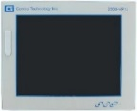




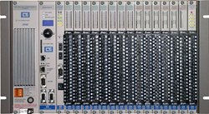









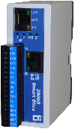

Smart ModernizationTM
Migration
2500 Series™ HMI Touch Panels featuring zenon
Migration
zenon or SCADA system of your choice
Supervisory layer
2500 Series™ PLC System
2500 Series™ Compact
Control layer
Coming Soon!
NEW 2500P Series™ PLC System with IEC-based programming package*
Legacy 500/505 System + HMI/SCADA
2500 Series™ Classic I/O
2500 Series™ Compact I/O
2500 Series™ Slice EtherNet Remote I/O
Device layer
Modernization
Modernization
Modernization
Modernization
Strategic migration
Replace legacy components with updated and upgraded CTI plug and play compatible replacements
Replace components with next generation CTI products that are backwards compatible
Replace components with next generation components that integrate seamlessly with CTI system
* Coming soon

Slide 14
End result of Smart Modernization?
Low cost: no expensive re-wiring, re-programming, re-engineering, re-training, re-validation
Low risk: reduce or avoid re-validation and
re-certifications
Minimal downtime: little, if any, downtime required
Preservation of intellectual property: reuse existing application programs
Improve process quality
Improve production capacity
Best return on investment
Best optimization of your long-term cost of ownership

Slide 15
“ Staying with the current [process control system] supplier is, in many cases, the easiest migration to perform…”
-- “The Control System Migration Survival Manual,” ARC Advisory Group, March 2010.

Slide 16
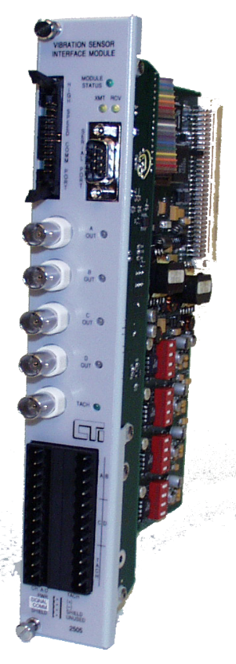

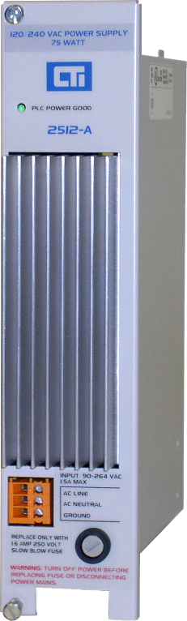
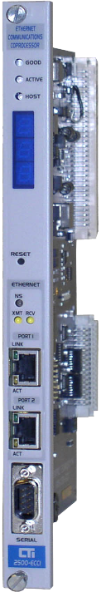
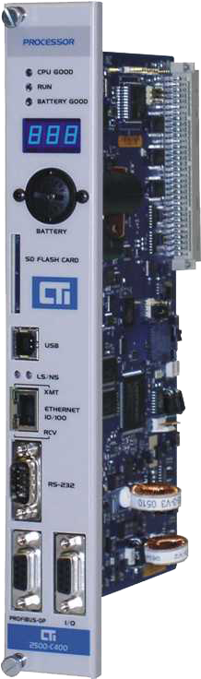
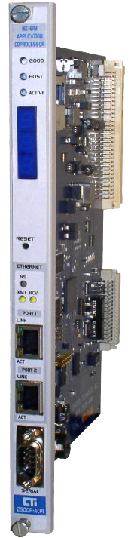
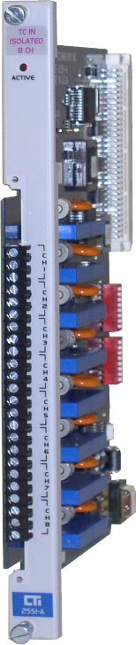

The BLUE PlatformTM
CTI 2500 Series® products are built on the BLUE PlatformTM — CTI’s seamless systems architecture. Products built on the BLUE PlatformTM are engineered with a consistent design philosophy, a common operating system and common communications protocols and interfaces.
This approach ensures interoperability between various components of the system as well as between various product generations to deliver seamless operational
communications and control and maximum efficiency with minimum process downtime
and greatly reduced engineering development time.
The BLUE PlatformTM enables you to optimize ROI and cost of ownership.

Slide 17
Thank You

